Slide 1
Chapter 17
Legal, Ethical, and Compliance
Issues in EC

Slide 2
Learning Objectives
Understand the foundations for legal and ethical issues in EC.
Describe civil, intellectual property, and common law.
Understand legal and ethical challenges and how to contain them.
Explain privacy, free speech, and defamation and their challenges.
Discuss the challenges caused by spam, splogs, and pop-ups.
Describe types of fraud on the Internet and how to protect against it.

Slide 3
Fundamental Legal,
Ethical, and Regulatory Issues
ethics
The branch of philosophy that deals with what is considered to be right and wrong
privacy
The right to be left alone and free of unreasonable personal intrusions
intellectual property
Creations of the mind, such as inventions, literary and artistic works, and symbols, names, images, and designs, used in commerce

Slide 4
Splogs and Search Engine Spam to Capture Customer Traffic
search engine marketing (SEM)
Marketing methods to increase the ranking of a Web site in the search results
search engine optimization (SEO)
Technique takes into consideration how search engines work (e.g., logical deep linking or strategic keyword) to maximize the number of qualified visitors to a site

Slide 5
Splogs and Search Engine Spam to Capture Customer Traffic
comment spam
Spam sent to all types of messaging media, including blogs, IM, and cellular telephones to promote products or services
search engine spam
Pages created deliberately to trick the search engine into offering inappropriate, redundant, or poor quality search results

Slide 6
Splogs and Search Engine Spam to Capture Customer Traffic
spam site
Page that uses techniques that deliberately subvert a search engine’s algorithms to artificially inflate the page’s rankings
splog
Short for spam blog. A site created solely for marketing purposes
search engine spamming
Collective term referring to deceptive online advertising practices

Slide 7
Fundamental Legal,
Ethical, and Regulatory Issues
Laws Are Subject to Interpretation
  Free speech online versus child protection debate
    Children’s Internet Protection Act (CIPA)
    Law that mandates the use of filtering technologies in schools and libraries that received certain types of U.S. federal funding
    legal precedent
    A judicial decision that may be used as a standard in subsequent similar cases

Slide 8
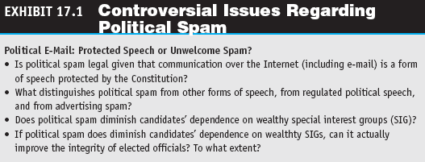
Fundamental Legal,
Ethical, and Regulatory Issues
  Political spam versus dependence on political fund-raising

Slide 9
Fundamental Legal,
Ethical, and Regulatory Issues
Law: A System for Social Control
  due process
  A guarantee of basic fairness and fair procedures in legal action
  right
  Legal claim that others not interfere with an individual’s or organization’s protected interest

Slide 10
Fundamental Legal,
Ethical, and Regulatory Issues
Law: A System for Social Control
  protected interests
  Interests, such as life, liberty, and property, that a national constitution protects
  duty
  Legal obligation imposed on individuals and organizations that prevents them from interfering with another ’s protected interest or right

Slide 11
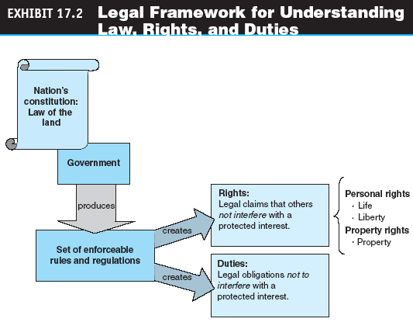
Fundamental Legal,
Ethical, and Regulatory Issues

Slide 12
Fundamental Legal,
Ethical, and Regulatory Issues
Personal and Property Rights
  civil litigation
  An adversarial proceeding in which a party (the plaintiff) sues another party (the defendant) to get compensation for a wrong committed by the defendant

Slide 13
Fundamental Legal,
Ethical, and Regulatory Issues
Personal and Property Rights
  Owners of property, including intellectual property, are entitled to:
    Control of the use of the property
    The right to any benefit from the property
    The right to transfer or sell the property
    The right to exclude others from the property

Slide 14
Fundamental Legal,
Ethical, and Regulatory Issues
Criminal Law and Civil Law
  CAN-SPAM Act
  Law that makes it a crime to send commercial e-mail messages with false or misleading message headers or misleading subject lines

Slide 15
Fundamental Legal,
Ethical, and Regulatory Issues
  Characteristics of criminal and civil laws
    crime
    Offensive act against society that violates a law and is punishable by the government
    criminal laws
    Laws to protect the public, human life, or private property
    statutes
    Rules that define criminal laws

Slide 16
Fundamental Legal,
Ethical, and Regulatory Issues
  civil laws
  Laws that enable a party (individual or organization) that has suffered harm or a loss to bring a lawsuit against whomever is responsible for the harm or loss
  Computer Fraud and Abuse Act (CFAA)
  Major computer crime law to protect government computers and other Internet-connected computers

Slide 17
Civil Law, Intellectual Property Law, and Common Law
Intellectual Property Law
  copyright
  An exclusive right of the author or creator of a book, movie, musical composition or other artistic property to print, copy, sell, license, distribute, transform to another medium, translate, record, perform, or otherwise use
  infringement
  Use of the work without permission or contracting for payment of a royalty

Slide 18
Civil Law, Intellectual Property Law, and Common Law
  digital rights management (DRM)
  An umbrella term for any of several arrangements that allow a vendor of content in electronic form to control the material and restrict its usage
  fair use
  The legal use of copyrighted material for noncommercial purposes without paying royalties or getting permission

Slide 19
Civil Law, Intellectual Property Law, and Common Law
  patent
  A document that grants the holder exclusive rights to an invention for a fixed number of years
  trademark
  A symbol used by businesses to identify their goods and services; government registration of the trademark confers exclusive legal right to its use

Slide 20
Civil Law, Intellectual Property Law, and Common Law
common law (case law)
Law created by judges in court decisions
tort
Civil wrong that can be grounds for a lawsuit

Slide 21
Civil Law, Intellectual Property Law, and Common Law
  Three types of torts:
    Negligence
    Nuisance
    Defamation
      libel
      Defamatory statement that is printed or broadcast over the media that causes damage
      slander
      Oral or spoken defamatory statement that causes damage

Slide 22
Legal and Ethical
Challenges and Guidelines
EC Ethical Issues
  Non-work-related use of the Internet
  Codes of ethics

Slide 23
Privacy,
Free Speech, and Defamation
Origin of Privacy Rights and the Evolution of Its Meaning
  Privacy is the right to be left alone and the right to be free of unreasonable personal intrusions
  To some extent privacy concerns have been overshadowed by post-September 11 terrorism efforts, but consumers still expect and demand that companies behave as responsible custodians of their personal data

Slide 24
Privacy,
Free Speech, and Defamation
  opt out
  Business practice that gives consumers the opportunity to refuse sharing information about themselves
  opt in
  Agreement that requires computer users to take specific steps to allow the collection of personal information

Slide 25
Privacy,
Free Speech, and Defamation
Free Speech
  Rights to privacy and free speech have an increasingly important role in an information society and to EC
The Price of Protection
  The Internet, in combination with large-scale databases, allows access to vast amounts of data can be used for good or ill

Slide 26
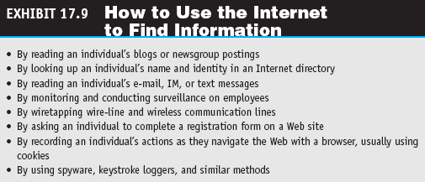
Privacy,
Free Speech, and Defamation

Slide 27
Privacy,
Free Speech, and Defamation
Ways of gathering information on the internet:
  Web site registration
  Cookies
  Spyware and similar methods
RFID’s threat to privacy
Privacy of employees
  darknet
  Private online community that is only open to those who belong to it

Slide 28
Privacy,
Free Speech, and Defamation
Privacy Protection
  Ethical principles commonly applied to the collection and use of personal information:
    Notice or awareness
    Choice or consent
    Access or participation
    Integrity or security
    Enforcement or redress

Slide 29
Privacy,
Free Speech, and Defamation
The USA Patriot Act
  The intent is to give law enforcement agencies broader range in their efforts to protect the public
  Concerns about the act include:
    Expanded surveillance with reduced checks and balances
    Over breadth with a lack of focus on terrorism
    Rules that would allow U.S. foreign intelligence agencies to more easily spy on Americans

Slide 30
Spam, Splogs, and Pop-Ups
Spam and Splogs
  comment spam
  Spam sent to all types of messaging media, including blogs, IM, and cellular telephones to promote products or services
  search engine spam
  Pages created deliberately to trick the search engine into offering inappropriate, redundant, or poor quality search results

Slide 31
Spam, Splogs, and Pop-Ups
  splog
  Short for spam blog. A site created solely for marketing purposes
  trackback
  An acknowledgment or signal from an originating site to a receiving site

Slide 32
Spam, Splogs, and Pop-Ups
  Automated spam
    Captcha tool
    Completely Automated Public Turing test to tell Computers and Humans Apart, which uses a verification test on comment pages to stop scripts from posting automatically

Slide 33
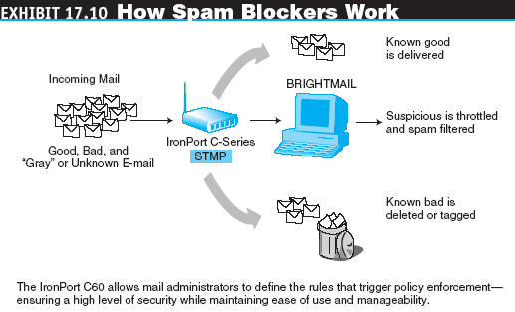
Spam, Splogs, and Pop-Ups

Slide 34
Spam, Splogs, and Pop-Ups
Protecting against Pop-Up Ads
  Tools for Stopping Pop-Ups
Fan and Hate Sites
  cyberbashing
  Domain name that criticizes an organization or person

Slide 35
Fraud and
Consumer and Seller Protection
Fraud on the Internet
  click fraud
  Scams and deceptions that inflate advertising bills by illicitly manipulating keyword-based advertising
  Other financial fraud

Slide 36
Fraud and
Consumer and Seller Protection
Other Legal Issues
  Electronic contracts
  electronic signature
  A generic, technology neutral term that refers to the various methods by which one can “sign” an electronic record
  digital signature
  Term for a technology specific type of electronic signature. It involves the use of public key cryptography to “sign” a message

Slide 37
Fraud and
Consumer and Seller Protection
Consumer Protection
  Tips for safe electronic shopping include:
    Use the real Web site of well-known companies
    Check any unfamiliar site for an address and telephone and fax numbers and call and quiz a salesperson about the seller
    Check out the seller with the local chamber of commerce, Better Business Bureau, or TRUSTe
    Investigate how secure and how well organized the seller’s site is
    Examine the money-back guarantees, warranties, and service agreements before making a purchase

Slide 38
Fraud and
Consumer and Seller Protection
Consumer Protection
  Tips for safe electronic shopping include:
    Compare prices online with those in regular stores—too-low prices may be too good to be true
    Ask friends what they know and find testimonials and endorsements
    Find out what redress is available in case of a dispute
    Consult the National Fraud Information Center (fraud.org)
    Check the resources available at consumerworld.org

Slide 39
Fraud and
Consumer and Seller Protection
  Third-party assurance services
    TRUSTe’s “Trustmark”
    Better Business Bureau
    WHICHonline
    Web Trust Seal and others
    Online Privacy Alliance
    Evaluation by consumers
  Authentication and biometric controls

Slide 40
Fraud and
Consumer and Seller Protection
Seller Protection
  The Internet makes fraud by customers or others easier because of the ease of anonymity by:
    Customers who deny that they placed an order
    Customers who download copyrighted software and/or knowledge and sell it to others
    Customers who give false payment
    Imposter sellers
    Use of others’ trademarks

Slide 41
Fraud and
Consumer and Seller Protection
  What Can Sellers Do?
    Use intelligent software to identify possibly questionable customers
    Identify warning signals for possible fraudulent transactions
    Ask customers whose billing address is different from the shipping address to call their bank and have the alternate address added to their bank account

Slide 42
Managerial Issues
What legal and ethical issues should be of major concern to an EC enterprise?
What are the most critical ethical issues?
Should we obtain patents?
What impacts on business is EC expected to make?

